Slide 6
Notes:
Hb = Hemoglobin

Slide 7
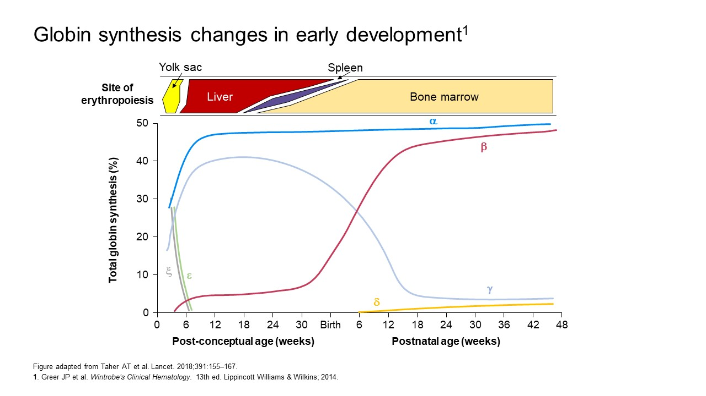

Slide 8
Notes:
Hb = hemoglobin

Slide 9
Notes:
HBA = alpha globin gene; HBB = beta globin gene

Slide 10
Notes:
Hb = hemoglobin; HbA = adult hemoglobin; HbF = fetal hemoglobin; HbH = hemoglobin H; RBC = red blood cell

Slide 11
Notes:
Hb= hemoglobin; HbH= hemoglobin H; MCH = mean corpuscular hemoglobin; MCV = mean corpuscular volume; RBC = red blood cell

Slide 12
Notes:
*The two symbols before the slash represent alleles for HBA1 and HBA2 on one chromosome; the 2 symbols after the slash represent alleles for HBA1 and HBA2 on the other chromosome
− = deletional mutation; α^{T} = non-deletional mutation

Slide 13
Notes:
Hb = hemoglobin; HbH= hemoglobin H

Slide 14
Notes:
Hb = hemoglobin; HbH= hemoglobin H

Slide 15
Notes:
Hb = hemoglobin; HbH= hemoglobin H

Slide 16
Notes:
HbH and HbBarts
~13,500 conceptions affected annually by α-thalassemia disorders*
5,500 perinatal deaths occur annually due to Hb Barts hydrops fetalis²
Non-deletional HbH mutations
Constant Spring non-deletional mutations have been found in up to 10% of the population in Northeastern Thailand and 5–8% of the population in Southern China**
*Modell B, Darlison M. Bull World Health Organ. 2008;86:480–487.
**Kalle Kwaifa I et al. Orphanet J Rare Dis. 2020;15:166
Hb = hemoglobin; HbH = hemoglobin H

Slide 17
Notes:
Hb = hemoglobin; HBA = alpha globin gene; RBC = red blood cell

Slide 19
Notes:
Decreased synthesis of α results in excess γ chains (in fetus), which form γ4 tetramers, called hemoglobin Bart’s; in adults, excess β chains form β4 tetramers, (HbH)
Because of their very high oxygen affinity, Both tetramers cannot transport oxygen due to high oxygen affinity; HbH is also unstable which leads to the production of inclusion bodies in RBCs and a variable levels of hemolysis (and ineffective erythropoiesis to a lesser degree than in beta-thal). Piel FB et al. N Engl J Med. 2014;371(20):1908–1916.
Hemolysis and ineffective erythropoiesis result in variable levels of anemia hypergoaculability and primary iron overload.
Hb = hemoglobin; HbA = adult hemoglobin; HbH= hemoglobin H; RBC = red blood cell

Slide 20
Notes:
All patients with HbH disease older than 45 years of age are susceptible to iron overload even if they do not receive regular blood transfusions
HbH= hemoglobin H; yr = year

Slide 21
Notes:
Hb = hemoglobin; HbH = hemoglobin H; MCH = mean corpuscular hemoglobin; MCV = mean corpuscular volume

Slide 22
Notes:
Hb = hemoglobin; MCV = mean corpuscular volume

Slide 23
Notes:
All complications seen in NTDT are also characteristic of TDT, however with adequate blood transfusion, many of these complications have become less common in patients with TDT.
Hb = hemoglobin; HbH= hemoglobin H; NTDT = Non-transfusion dependent thalassemia; TDT = Transfusion Dependent Thalassemia

Slide 24
Notes:
HbH= hemoglobin H; RBC= red blood cell

Slide 25
Notes:
BMD = bone mineral density; Hb = hemoglobin; HbH= hemoglobin H; RBC = red blood cell

Slide 26
Notes:
Neonatal complications include pulmonary hypertension, respiratory distress syndrome, pulmonary hemorrhage, convulsions, brain infarction, intraventricular hemorrhage, bilateral pneumothorax, pericardial effusion, septicemia, thrombocytopenia, and portal vein thrombosis⁴
Hb = hemoglobin; MCH = mean corpuscular hemoglobin; MCV = mean corpuscular volume; WBC = white blood cell

Slide 27
Notes:
Craniofacial abnormalities (microcephaly, frontal hair upsweep, telecanthus, short triangular nose, tented upper lip, thick or everted lower lip, open mouth)
Growth impairment present at birth
Genital abnormalities (eg, hypospadias, undescended testes, ambiguous or female genitalia)
Developmental delay (DD) with severe to profound intellectual disability (ID)
Co-occurring mild α-thalassemia in up to 75% of affected males
CBC = complete blood count; HbH= hemoglobin H; RBC = red blood cell

Slide 28
Notes:
Hb = hemoglobin; HbA = adult Hb; HbH= hemoglobin H; RBC = red blood cell

Slide 30
Notes:
DNA = deoxyribonucleic acid; Hb = hemoglobin; NTDT = non-transfusion dependent thalassemia; RBC, red blood cell

Slide 31
Notes:
BCB = Brilliant cresyl blue; CBC = complete blood count; Hb = hemoglobin; HbA and HbA2 = adult types of Hb; HbF = fetal Hb; HbE = E type Hb; HbH = hemoglobin H disease; HPLC = high-performance liquid chromatography; MCH = mean corpuscular hemoglobin; MCV = mean corpuscular volume; NTDT = non-transfusion dependent thalassemia; RBC, red blood cell; TSAT, transferrin saturation

Slide 32
Notes:
Speaker notes:
Complete blood count
MCV levels < 80 fL and MCH < 27 pg indicate positive screening results
Results may be due to iron deficiency anemia, thus additional confirmatory tests are needed
Blood smear
Thalassemic RBCs show microcytosis, hypochromic, anisocytosis, and poikilocytosis
RBCs with inclusion bodies indicate presence of HbH
HPLC
Quantifies Hb level
Measures HbA2, HbF, and other Hb variants
Limited in detecting and quantifying HbH and Hb Barts percentage, and has low sensitivity to detecting non-deletional forms of HbH (eg, Constant Spring)
Capillary/gel electrophoresis
Used to separate and quantify HbA2, HbE, HbF, HbH, HbBarts and some Hb variants, which is required to make a presumptive diagnosis of α-thalassemia
Molecular genetic testing
Required to understand the clinical phenotype and definitively confirm a diagnosis of α-thalassemia
Hb = hemoglobin; HbA and HbA2 = adult types of Hb; HbF = fetal Hb; HbE = E type Hb; HPLC = high-performance liquid chromatography; MCH = mean corpuscular Hb; MCV = mean corpuscular volume; RBC = red blood cell

Slide 33
Notes:
CBC = complete blood count; Hb = hemoglobin; MCH = mean corpuscular Hb; MCV = mean corpuscular volume; RBC = red blood cell; ZPP = zinc protoporphyrin

Slide 34
Notes:
CBC = complete blood count; Hb = hemoglobin; MCH = mean corpuscular Hb; MCV = mean corpuscular volume; RBC = red blood cell

Slide 35
Notes:
Hb = hemoglobin; HbA and HbA2 = adult types of Hb; HbE = E type Hb; HbF = fetal Hb; HPLC = high-performance liquid chromatography

Slide 36
Notes:
LAMP = loop-mediated isothermal amplification; MLPA = multiplex ligation-dependent probe amplification; NGS = next-generation sequencing; PCR = polymerase chain reaction

Slide 37
Notes:
CBC = complete blood count; Hb = hemoglobin; HPLC = high-performance liquid chromatography; MCV = mean corpuscular volume

Slide 38
Notes:
If fetus found to be positive for α-thalassemia major, review management options with parents (in utero transfusions, in utero stem cell transplantation study, expectant management or termination)
CBC = complete blood count; Hb = hemoglobin; HbA and HbA2 = adult types of Hb; MCH = mean corpuscular Hb; MCV = mean corpuscular volume

Slide 39
Notes:
Hb = hemoglobin; Hb A2 = adult type of Hb; MCV = mean corpuscular volume; HPLC = high-performance liquid chromatography; TIBC = total iron binding capacity

Slide 40
Notes:
Hb = hemoglobin; HPLC = high-performance liquid chromatography

Slide 43
Notes:
Deletional: NTDT iron chelation therapy: to manage iron overload when serum ferritin is ≥ 1000 ng/mL
Nondeletional: NTDT or TDT: regular or intermittent transfusions to maintain Hb at > 9 g/dL
Splenectomy: might be considered for patients with baseline Hb < 7 g/dL and hepatosplenomegaly¹
Hb = hemoglobin; NTDT = non-transfusion-dependent thalassemia; RBC = red blood cell; TDT = transfusion-dependent thalassemia

Slide 44
Notes:
Major/Hb Barts Hydrops Fetalis¹
Treatment approach
Genetic counseling is recommended for couples at risk of having an affected child
Intra-uterine RBC transfusions have been performed with some success in a small number of cases
Considerations/Challenges
Patients who survive due to intra-uterine RBC transfusions will require regular lifelong transfusions and iron chelation
Patients are likely to have severe congenital abnormalities and delays in cognitive and motor functions
Hb = hemoglobin; HSCT = hematopoeitic stem cell transplanation; RBC = red blood cell

Slide 45
Notes:
Hb = hemoglobin; HbH = hemoglobin H; HSCT = hematopoeitic stem cell transplanation; NTDT = non-transfusion dependent thalassemia; RBC = red blood cell; TDT = transfusion-dependent thalassemia

Slide 46
Notes:
Because HbH patients, in general, have rather high hemoglobin levels (8-9 g/dL), they do not need regular blood transfusions or iron chelation.
HbH = hemoglobin H; TDT= transfusion-dependent thalassemia

Slide 47
Notes:
Hb = hemoglobin; HbH = hemoglobin H; P = percentile; TDT = transfusion-dependent thalassemia

Slide 48
Notes:
Notes:
Episodic: Restore patient’s hemoglobin to 8-9 g/dL by red cell transfusion
Identify the cause of infection/inflammation and provide appropriate treatment
If TDT: transfusion every 2–5 weeks to maintain pre-transfusion Hb of ≥9– 10.5 g/dL, usually within the first 2 years of life, with the following criteria:
Confirmed diagnosis of TDT
Hb <7 g/dL on 2 occasions >2 weeks apart
Clinical signs/symptoms regardless of Hb level:
Severe symptomatic anemia
Poor growth/Failure to thrive
Complications of intramedullary hematopoiesis (eg, pathological fractures or facial changes)
Clinically significant extramedullary hematopoiesis
Preventative transfusions in high-risk populations may be done for prevention or management of complications
Hb = hemoglobin; HbH = hemoglobin H; NTDT = non-transfusion-dependent thalassemia; TDT = transfusion-dependent thalassemia

Slide 49
Notes:
Hb = hemoglobin

Slide 50
Notes:
Fe = iron; Hb= hemoglobin; HbH = hemoglobin H; LIC = liver iron concentration; MRI = magnetic resonance imaging; P= percentile; NTDT = non-transfusion-dependent thalassemia; SF = serum ferritin; TDT = transfusion dependent thalassemia

Slide 51
Notes:
Hb = hemoglobin; HbH = hemoglobin H

Slide 52
Notes:
1. Viprakasit V. Alpha-thalassemia syndromes: From Clinical and Molecular Diagnosis to Bedside Management. 2013. https://library.ehaweb.org/eha/2013/18th/31667/vip.viprakasit.alpha-thalassemia.syndromes.from.clinical.and.molecular.html. Available at: Accessed June 3 2022. 2.Viprakasit V. Alpha-thalassemia syndromes: from clinical and molecular diagnosis to bedside management. 2013. Available at: https://library.ehaweb.org/conference/documents/97379/red_cell_disease_2_alphathalassemia_syndromes_from_clinical_and_molecular_diagnosis_to_bedside_management.pdf. Accessed June 3,2022.
Hb = hemoglobin

Slide 53
Notes:
GvHD = graft-versus-host disease; HLA = human leukocyte antigen; HSCT = hematopoietic stem cell transplantation; MRI = magnetic resonance imaging

Slide 54
Notes:
MRA = magnetic resonance angiography; MRI = magnetic resonance imaging; PCR = polymerase chain reaction

Slide 55
Notes:
Hb = hemoglobin; HbH = hemoglobin H; NTDT = non-transfusion-dependent thalassemia; TDT = transfusion-dependent thalassemia

Slide 57
Notes:
BMD = bone mineral density; CBC = complete blood count; Hb= hemoglobin; HbH = hemoglobin H; HSCT = hematopoietic stem cell transplantation; NTDT = non-transfusion-dependent thalassemia; P= percentile; TDT = transfusion dependent thalassemia

Slide 61
Notes:
CBC = complete blood count; DNA = deoxyribonucleic acid; Hb = hemoglobin; HbA and HbA2 = adult types of Hb; MCA = middle cerebral artery; MCH = mean corpuscular Hb; MCV = mean corpuscular volume; U/S = ultrasound; PCR = polymerase chain reaction

Slide 63
Notes:
LDH = lactate dehydrogenase; MCH = mean corpuscular hemoglobin; MCHC = mean corpuscular hemoglobin concentration; MCV = mean corpuscular volume; RBC = red blood cell; RDW = red cell distribution width; WBC = white blood cell;

Slide 64
Notes:
CBC = complete blood count; Hb= hemoglobin; HbA and HbA2 = adult types of hemoglobin; HbF = fetal hemoglobin; HbH = hemoglobin H; P= percentile; RBC = red blood cell; TDT = transfusion dependent thalassemia

